Slide 1

Facebook Ads
Thrillophilia
Project
Abhishek Pawar

Slide 2
Assignment Brief
Draft a conversion-oriented campaign structure on Thailand Tour Packages.
(https://www.thrillophilia.com/countries/thailand/tours/).
You have a budget of Rs 5,00,000 per month for these destinations. Geo-Targeting: UAE.

Slide 3
Budget Distribution
Monthly Campaign Budget Distribution
 | Month 1 | Month 2 | Month 3 | Same Budget distribution may continue likewise for upcoming months. Based on Campaign performance
Awareness | 1,50,000/- | 1,50,000/- | ---
Lead Generation | --- | 2,00,000/- | 2,00,000/-
Conversion | --- | --- | 2,50,000/-
Total Monthly Spending | 1,50,000/- | 3,50,000/- | 4,50,000/-

Slide 4
Campaign Timeline
TIMELINE
Awareness | 2 Months from starting
Lead Generation | Starting From 2nd Month
Conversion | Starting From 3rd Month
Here we are assuming that we have no previous data to run direct conversion campaign. So we are getting audience from top of the funnel. We will be starting from awareness campaign for 2 Months so we can retarget audience in upcoming campaigns which is lead generation and Conversion. By this method we will be able to pull audience at bottom of the Consumer funnel so we can achieve our conversion goal.

Slide 5
Awareness Campaign Structure
Awareness
Objective :- Brand Awareness
Optimization and Delivery :- Thru-play
Budget :- 1,50,000/- (CBO)
Bidding Type :- Highest Volume
KPI’s :- Cost Per View

Slide 6
Awareness Ad Group Structure
Audiences :- Ad Group 1
Location :- Dubai/UAE
Age :- 20-50
Gender :- Male & Female
Targeting :- Core Audience
(Interests: Travel Blogger, Tourism in Thailand, Travel or Package tour,
Behaviors: Frequent travellers, Commuters or Frequent international travellers)
Placements :- Automatic

Slide 7
Awareness Ad Group Structure
Audiences :- Ad Group 2
Location :- Dubai/UAE
Age :- 20-50
Gender :- Male & Female
Targeting :- Core Audience (competitor)
(Interests: Kayak.com, Virgin Holidays, Airbnb, Cheap Tickets, Thomas Cook, MakeMyTrip, Hotels.com, Yatra.com, Trivago, Booking.com or Agoda.com)
Placements :- Automatic

Slide 8
Awareness Ad Structure
Ad Creative
15 Sec Video Ad: These ad will feature stunning visuals of Thailand destinations like Bangkok, Phuket, Chiang Mai, etc. to create the desire to explore the country. These ads will also highlight the special deals and offers that Thrillophilia is providing on its Thailand tour packages.
Note :- Separate ad creative for both the Ad groups according to the audience we have selected. Which will deliver relevant message for selected audience.

Slide 9
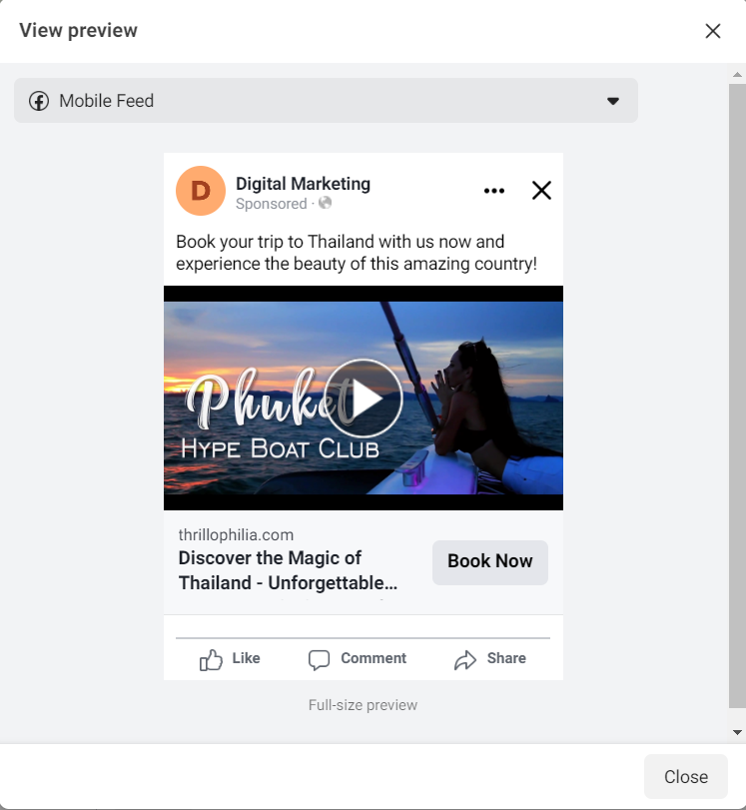
Ad Copy
Headline:- Discover the Magic of Thailand - Unforgettable Vacation Awaits!
Description:- Come explore Thailand's beautiful beaches, stunning temples, and rich culture. With Thrillophilia, you can customize your perfect vacation and make the most of this incredible destination. Experience the wonders of Thailand today!
Primary Text:- Book your trip to Thailand with us now and experience the beauty of this amazing country!
CTA:- Book Now
Display URL:- Thrillophila.com
Destination URL:-https://www.thrillophilia.com/countries/thailand/tours/
Note :- Ad Creative are randomly taken from Internet

Slide 10
Conversion Campaign Structure
Consideration/Conversion
Objective :- Lead Generation
Budget :- 2,00,000/-
Bidding Type :- Highest Volume
KPI’s :- Cost Per Lead

Slide 11
Conversion Ad Group Structure
Audiences :- Ad Group 1
Optimization and Delivery :- Conversion
Custom Audience :- Retargeting Video Viewers
(From Awareness Campaign Who watched 95% video)
Conversion Location :- Website
Conversion Event :- Lead

Slide 12
Conversion Ad Structure
Ad Creative
Carousel Ads: These ads will be used to highlight the various Thailand tour packages that Thrillophilia is offering. It will showcase pictures of the popular destinations in Thailand and the package details.

Slide 13
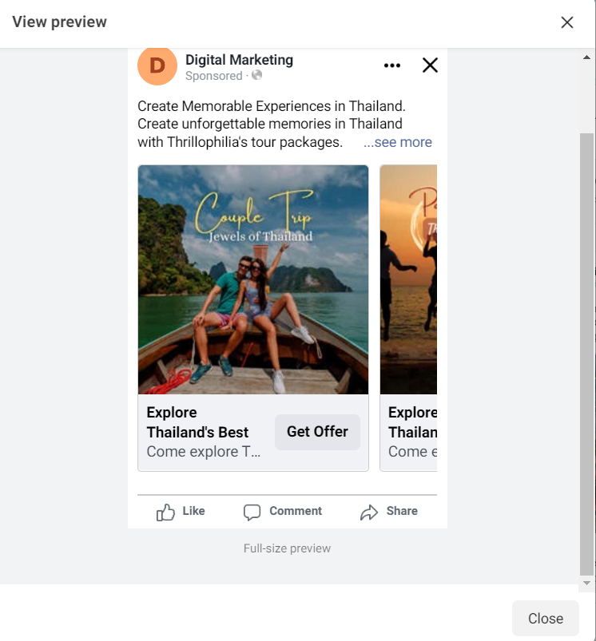
Ad Copy
Headline:- Explore Thailand's Best Tour Packages
Description:- Come explore Thailand's beautiful beaches, stunning temples, and rich culture. With Thrillophilia, you can customize your perfect vacation and make the most of this incredible destination. Experience the wonders of Thailand today!
Primary Text:- Create Memorable Experiences in Thailand. Create unforgettable memories in Thailand with Thrillophilia's tour packages. Check out our amazing deals and book now!
CTA:- Get Offer
Destination URL:-https://www.thrillophilia.com/countries/thailand/tours/
Note :- Ad Creative are randomly taken from Internet

Slide 14
Conversion Campaign Structure
Conversion
Objective :- Conversion
Budget :- 2,50,000/-
Bidding Type :- Highest Volume
KPI’s :- Cost Per Conversion

Slide 15
Conversion Ad Group Structure
Audiences :- Ad Group 1
Optimization and Delivery :- Conversion
Custom Audience :- Retargeting
(Audience who visited page but didn’t Convert)
Conversion Location :- Website
Conversion Event :- Custom Event

Slide 16
Conversion Ad Structure
Ad Creative
Video Ads: These ads will focus on showcasing the unique experiences that customers can have while exploring Thailand. These ads will combine visuals and audio to engage the audience. With some additional discount. Also These ads Can be used to tell stories of customers who have already explored Thailand.

Slide 17
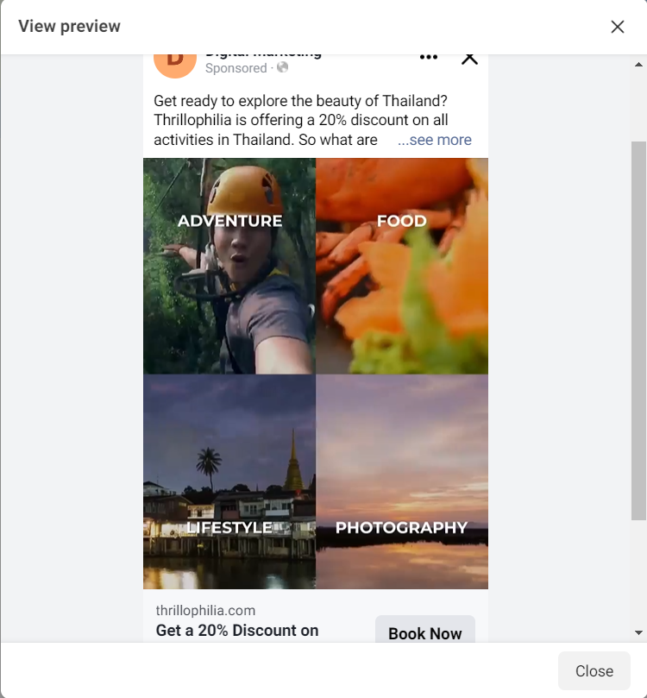
Ad Copy
Headline:- Get a 20% Discount on Thrilling Activities in Thailand!
Description:- Unlock exclusive discounts on adventure activities in Thailand with Thrillophilia!
Primary Text:- Are you ready to explore the beauty of Thailand? Thrillophilia is offering a 20% discount on all activities in Thailand. So what are you waiting for? Book now and get ready for a thrilling experience in Thailand!
CTA:- Book Now
Display URL:- thrillophilia.com
Destination URL:-https://www.thrillophilia.com/countries/thailand/tours/
Note :- Ad Creative are randomly taken from Internet

Slide 18
Shaping the future of travel

